Slide 1
Parameter Estimation

Slide 2
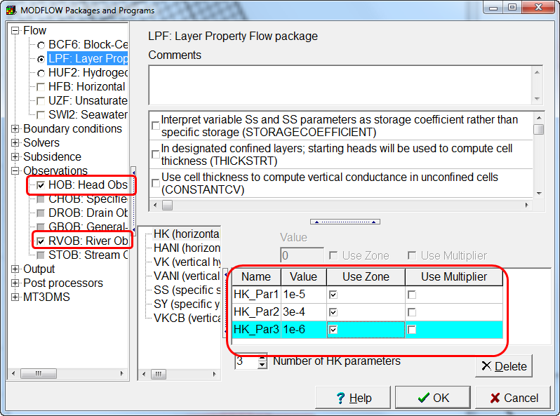
Model Requirements
Define parameters
Define observations
Head observations
Flow observations

Slide 3
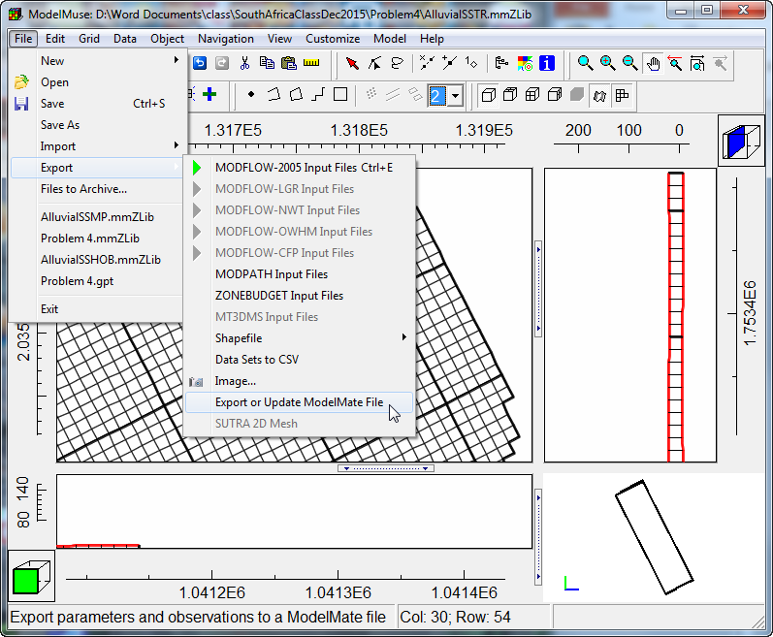
Export to ModelMate

Slide 4
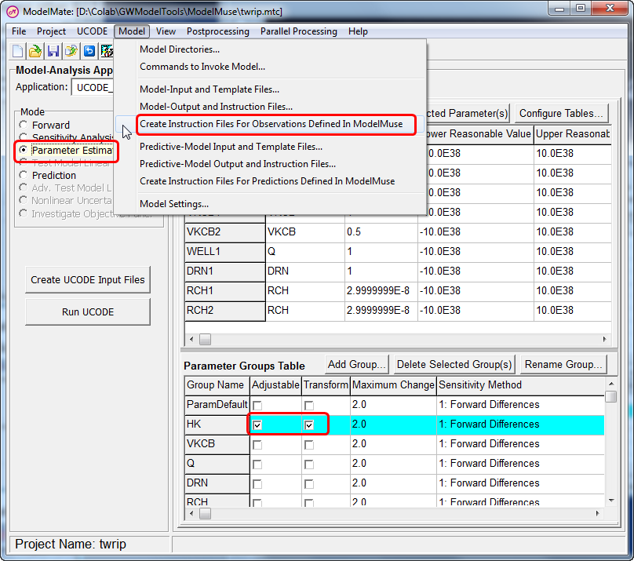
Create Template files
Choose Adjustable Parameters
Perform Parameter Estimation

Slide 5
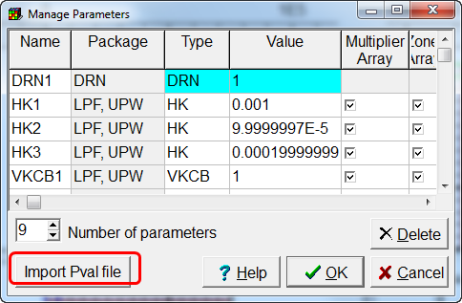
Import Updated Parameters

